Slide 1
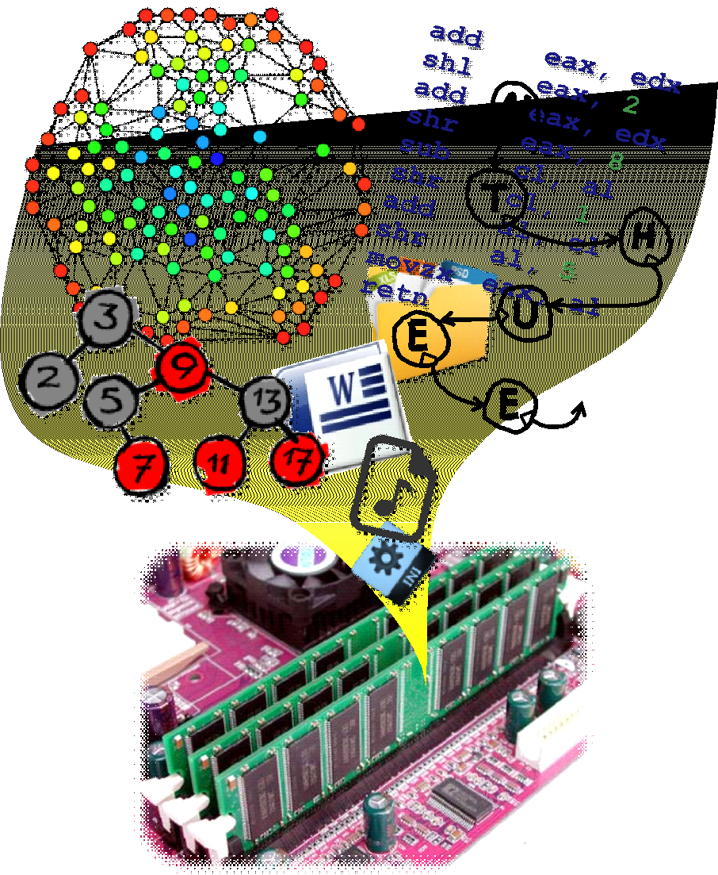
EECS2040 Data Structures
Syllabus
Prof. Tai-Lang Jong
Office: Delta 928
Tel: 42577
email: tljong@mx.nthu.edu.tw

Slide 2
EECS2060 Data Structures
Class Hour:
Tue. 15:30-17:20,
Thur. 15:30-16:20
Classroom: EECS 208
Office Hour: Tue. 10:00-12:00
TA: EECS819劉哲豪、何岳庭、王彬泓、吳瑀翔(34148)

Slide 3
Course Description
Data structures?
A data structure is a particular way of organizing data in a computer so that it can be used effectively.
The idea is to reduce the space and time complexities of different tasks.
Data structures can be considered as essential building blocks in modern computer science.
The objective of this course:
To provide a solid training for understanding various data structures, including their design, analysis, and implementation.

Slide 4
Textbook
Horowitz, Sahni, Mehta, Fundamentals of data structures in C++, 2nd ed.,

Slide 5
References
Data Structures and Algorithms. Aho, Ullman & Hopcroft
Data Structures and Algorithms. Alfred V. Aho, Jeffrey D. Ullman, John E. Hopcroft. Addison Wesley, 1983.
A Common-Sense Guide to Data Structures and Algorithms, 2nd ed. Jay Wengrow
The Art of Computer Programming, Volumes 1-3. Donald E. Knuth. Addison-Wesley Professional, 1998.
Data Structures and Algorithms Made Easy: Data Structures and Algorithmic Puzzles. Narasimha Karumanchi
Interesting webpages:
https://www.cprogramming.com/algorithms-and-data-structures.html

Slide 6
Syllabus
BASIC CONCEPTS
INTRODUCTION TO ALGORITHM
C++ Review
ARRAYS
STACKS AND QUEUES
LINKED LISTS
TREES
GRAPHS
SORTING
HASHING AND ADVANCED TOPICS

Slide 7
Teaching Method
This course is a three hours lecture course. You will have several simple take-home project assignments, quizzes, a mid-term exam, and a final exam.

Slide 8
Grading Policy
Homework assignments (projects) & quizzes 50%
mid-term exam 25%
4/27(Tue.) T7T8 @EECS208
final exam 25%
6/22(Tue.)T7T8 @EECS208
Bonus: attendancy

Slide 9
Tentative Class Schedule
1 | 2/23 | 3 | Basic Concepts, Introduction to Algorithm
2 | 3/2 | 3 | Introduction to Algorithm, C++ review | 3/1 (2/28和平紀念日補假), 3/5梅竹賽
3 | 3/9 | 3 | Arrays
4 | 3/16 | 3 | Arrays
5 | 3/23 | 3 | Stack & queue
6 | 3/30 | 3 | Stack & queue | 期中教學意見反映週(至4/5日止)
7 | 4/6 | 3 | Linked list | 4/5民族掃墓節暨兒童節補假,4/7校際活動週(停課一日)
8 | 4/13 | 3 | Linked list | 4/12申請課程停修開始(至5月10日止)
9 | 4/20 | 3 | Trees
10 | 4/27 | 1 | Trees | 4/27 Midterm exam
11 | 5/4 | 3 | Trees, Graphs
12 | 5/11 | 3 | Graphs
13 | 5/18 | 3 | Graphs
14 | 5/25 | 3 | Sorting | 5/29畢業典禮,5/28教學意見調查開始(至6月20日止)
15 | 6/1 | 3 | Sorting
16 | 6/8 | 3 | Hashing
17 | 6/15 | 3 | Hashing | 6/14端午節
18 | 6/22 |  |  | Final Exam, 7/9送繳本學期成績截止(6/28應屆畢業生)

